Slide 1

Composing Asynchronous Operations Using TPL Dataflow
Dave Marini and Erez Testiler
Taskmatics, LLC
Notes:
A bit of background on Taskmatics, we are the developers of Taskmatics Scheduler, a job scheduling engine made specifically for .NET developers. Our goal was to make it much easier for developers to create, schedule and manage automated tasks.
We’re really excited to have just launched our beta and would love for you guys to download, play with it and provide feedback.
We use Dataflow in the Scheduler to manage make our lives easier when it comes to managing concurrent workflows and today I’m going to show you how you can use it to the same end.

Slide 2
Agenda
Concurrency complexity
Introduction to TPL Dataflow
Starting Lineup
Block Configuration
Composing Blocks
Extensibility
Demos
Notes:
We’re going to be….
Talking about where to use dataflow and the complexity it helps alleviate.
Introducing the basic concepts around dataflow and some of the core features
Take a tour of the different “blocks” that are available in the library
Discussing the configurability, composability and extensibility of the blocks
Erez will be going through a few demos using Dataflow.

Slide 3
Complexity of Multi-Threading
Extensive Dev/Debug Time
Thread Safety
Synchronization
Notes:
Often when processing data, things can get complicated pretty quickly..
Simple case of single threaded for loop over finite list xml documents being inserted in a database.
Storing data requires definition of class with lock object and methods to add/remove
If we need to process documents as they come in, need to add queueing/threading
What if pieces of the document are coming from multiple places, now we need thread synchronization primitives like waithandles
The code and debug involved for these scenarios takes a good chunk of time.

Slide 4
.NET 4 Improvements
Task
Cornerstone of the Task Parallel Library
Implements promise pattern as opposed to callbacks through Async Programming Model
Encapsulates task state and error info
Thread Safe Collections
ConcurrentDictionary<Tkey, Tvalue>
ConcurrentQueue<T>
BlockingCollection<T>
Notes:
Some features introduced with .NET 4.0 help reduce some of the complexities of multi-threaded processing.
Task – Cornerstone of the Task Parallel Library
Concurrent classes – give us built in thread safety

Slide 5
Where is Dataflow?
Not shipped with the standard .NET libaries
Get it from NuGet Package Manager
Install –Package Microsoft.Tpl.Dataflow

Slide 6



Slide 7
What is Dataflow?
A set of “blocks” that can be composed into a pipeline that queues/pushes data asynchronously.
A block can be a target, source or both!
Blocks are logically organized into categories based on what they do…
Buffering/Routing
Execution/Transformation
Grouping
Notes:
Also can be thought of as an in memory message passing framework.
Blocks spawn one or more Tasks as necessary to perform work and participate in the rest of the flow.
Synchronization is handled for you. Data will be passed between connected blocks in sequence.

Slide 8
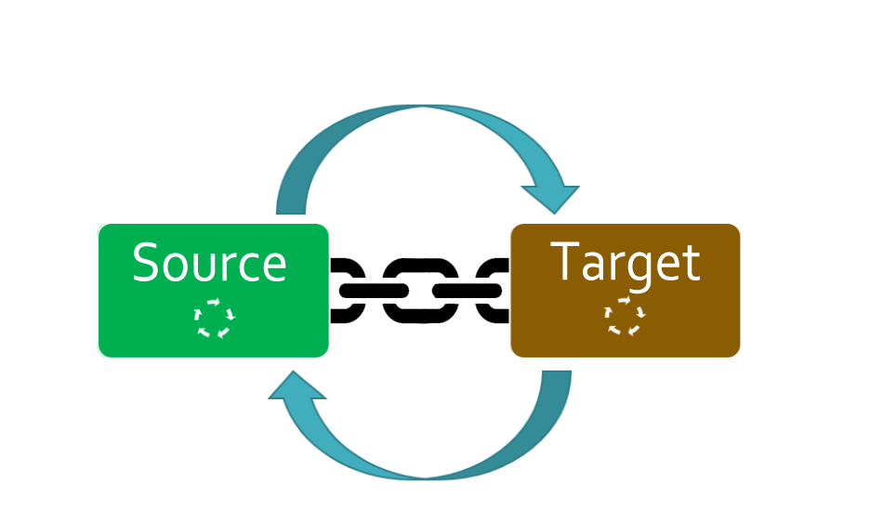
How Dataflow Works
Source blocks offer data to one or more target blocks.
Target blocks can choose to consume or postpone data.
Consumed data is removed from the source block queue and processed by the target block (in most cases).
Notes:
Each block runs one or more tasks as necessary that both process data messages as well as work to propel the processed results to other blocks in the pipeline.
All blocks support a way to stop further processing (complete), This completion can be propagated throughout the pipeline via configuration (shown later).
Message sequence is maintained by all blocks, regardless of concurrency settings
At least one target must accept every message, or else the whole system grinds to a halt.

Slide 9
Dataflow at a Glance
Buffering
BufferBlock
Execution
ActionBlock
TransformBlock
Grouping
BatchBlock
JoinBlock
TransformManyBlock
BatchJoinBlock
BroadcastBlock
WriteOnceBlock
Notes:
Buffering blocks store/route data to one or more targets.
Execution blocks are for manipulation of data. Each block executes a specific action on the received data.
Grouping blocks are responsible for aggregation of data. Example: Batch data to ActionBlock to put records into a database instead of one at a time.
Helpful to keep categorization of the blocks in mind since configuration is somewhat delineated by the categorizations.
Each block category has its own options object that configures member blocks with various settings used during its lifetime

Slide 10
Buffering Blocks

Slide 11
BufferBlock<T>
Thread Safe queue
Can source data to other blocks in the pipeline
Capacity can be configured
var myBuffer = new BufferBlock<int>(new DataflowBlockOptions { BoundedCapacity = 1 });myBuffer.Post(1);
myBuffer.Post(2); //returns false;
myBuffer.SendAsync(3).Wait(); //blocks until buffer can accept message;
Notes:
BufferBlock is basically a thread safe in memory queue.
Can post messages to it synchronously through post or asynchronously via sendAsync
Data taken off the queue by the first target that will accept it.

Slide 12
BroadcastBlock<T>
Like BufferBlock<T>, sources data to other blocks
Holds only the most recent message
Useful for sending data to multiple targets
Func<int, int> cloneMe = (i) => i;
var broadcaster = new BroadcastBlock<int>(cloneMe);
broadcaster.Post(1);
broadcaster.Post(2); //replaces 1 as current data message.
Notes:
BroadcastBlock is useful when you need to copy data to multiple targets
Only stores one data message, overwriting the current message in the queue
Pay attention to clone delegate.

Slide 13
WriteOnceBlock<T>
Like BroadcastBlock, can send copies of message data to multiple targets
Holds first posted message
Drops all subsequent messages
Func<int, int> cloneMe = (i) => i;
var writeOnce = new WriteOnceBlock<int>(cloneMe);
writeOnce.Post(1);
writeOnce.Post(2); //completely ignored, returns false.
Notes:
WriteOnceBlock is very similar to BroadcastBlock with one distinct exception. It will drop all but the first message posted to it.
Can be useful in situations where you want to act on the winner of a data race, perhaps choosing the service with the fastest ping, for example.

Slide 14

Execution Blocks

Slide 15
ActionBlock<T>
Likely the most useful block when used on its own
Executes a specified Action delegate on each data message with optional parallelism
Target role only, no source functionality
Notes:
Can be parallelized using the MaxDegreeOfParallelism configuration option.
Does not propagate messages to other blocks, but you can post to another target block from the delegate itself if you need re-entrant behavior.
Supports Async processing of delegate as well when the delegate is performing IO bound work that can be offloaded to OS.

Slide 16
ActionBlock<T>
var dbWriter = new ActionBlock<string>(
doc =>
{
var sqlCommand = GetCommand(doc);
sqlCommand.ExecuteNonQuery();
});
var dbWriter = new ActionBlock<string>(
async doc =>
{
var sqlCommand = GetCommand(doc);
await sqlCommand.ExecuteNonQueryAsync();
});
Notes:
Does not propagate messages to other blocks, but you can post to another target block from the delegate itself if you need re-entrant behavior.
Supports Async processing of delegate as well when the delegate is performing IO bound work that can be offloaded to OS.

Slide 17
TransformBlock<TInput, TOutput>
Similar to LINQ‘s “Select”
Like ActionBlock, supports async delegates
var urlToXml = new TransformBlock<string, XElement>(
async uri =>
{
var xmlString = await new WebClient().DownloadStringTaskAsync(uri); return XElement.Parse(xmlString);
});
Notes:
Takes a delegate that can project a target type from a specified source data type
It’s both a target and a source, so it participates in propagation

Slide 18
TransformManyBlock<TInput, TOutput>
Mimics LINQ’s “SelectMany”
Similar as TransformBlock, but returns a collection
var stringExpander = new TransformManyBlock<string, char>(alpha => alpha.ToArray());
stringExpander.Post("abcdefghijklmnopqrstuvwxyz");

Slide 19
Grouping Blocks

Slide 20
BatchBlock<T>
Queues individual data messages, propagates collections of a specified size.
Can be manually flushed using TriggerBatch method
var batcher = new BatchBlock<Order>(50);
var orderProcessor = new ActionBlock<Order[]>(
orders => Order.SendOrdersAsync(orders));
batcher.LinkTo(orderProcessor);

Slide 21
JoinBlock<T1,T2>
Similar to joining multiple threads and working with the results
Useful for combining data from multiple sources
var joiner = new JoinBlock<string, int>();
var action = new ActionBlock<Tuple<string, int>>(
data => Console.WriteLine("{0} is {1} years old!",
data.Item2,
data.Item1));
joiner.LinkTo(action);
joiner.Target1.Post("Dave");
joiner.Target2.Post(21);
Notes:
Aggregates data from two or three sources and outputs a tuple comprised of elements of each source

Slide 22
Block Configuration
DataflowBlockOptions
BoundedCapacity
CancellationToken
TaskScheduler
ExecutionDataflowBlockOptions
MaxDegreeOfParallelism
GroupingDataflowBlockOptions
Greedy
Notes:
Each category of block can be configured for parallelism and consumption behavior, which determine the performance of the block network as a whole.
BoundedCapacity – Limits number of messages that can be waiting for processing
MaxDegreeOfParallelism - controls how many messages are processed concurrently
Greedy – Makes a block accept every message that is offered to it. Turning off this behavior allows block to postpone messages until data from all sources are received. This reduces the potential for deadlocks.
For more information about any of these configuration properties, feel free to hit me up after the presentation

Slide 23
Linking Blocks
Allow propagation of data between blocks
Used to compose more complex pipelines or networks of data
Links serve as both conduits and also barriers (when necessary)
Can be configured via DataflowLinkOptions
Append
MaxMessages
PropagateCompletion
var nameBuffer = new BufferBlock<string>();
var sayhello = new ActionBlock<string>(name => Console.WriteLine("Hello {0}", name));nameBuffer.LinkTo(sayhello, new DataflowLinkOptions{ PropagateCompletion = true });
nameBuffer.Post("Dave");
nameBuffer.Post("Erez");
nameBuffer.Complete();
Notes:
Append – defines whether to append prepend the given target to the source. Useful for dynamic ordering
MaxMessages – controls how many messages can be consumed over the link
Under the hood, removes the linked target from the source block
Propagate Completion – useful in pipeline (linear) situations where completing the source will propagate completion to all target stages in the pipeline.
Be careful when using this on actionblock linked to multiple sources. In this case, manually set complete in a continuation or a manual call to Complete().

Slide 24
Linking Blocks
Buffer
Action (Fedex)
var buffer = new BufferBlock<Order>();
var sendOrders = new ActionBlock<Order>(order => Order.SendToFedex(order));
buffer.LinkTo(sendOrders);

Slide 25
Linking Blocks
Buffer (Orders)
Action (Fedex)
Action (Ups)
var buffer = new BufferBlock<Order>();
var sendFedexOrders = new ActionBlock<Order>(order => Order.SendToFedex(order));
var sendUpsOrders = new ActionBlock<Order>(order => Order.SendToUps(order));
buffer.LinkTo(sendOrdersFedex, order => order.Carrier == Carrier.Fedex);
buffer.LinkTo(sendOrdersUps, order => order.Carrier == Carrier.Ups);

Slide 26
Dataflow Extensibility
Set of interfaces allow for customized block behavior
Build your own block that will implicitly participate data propagation
Combine existing blocks to encapsulate a more complex flow
Notes:
Each category of block can be configured for parallelism and consumption behavior, which determine the performance of the block network as a whole.
BoundedCapacity – Limits number of messages that can be waiting for processing
MaxMessagesPerTask – useful for fairness in systems that have heavy anticipated threadpool contention.
MaxDegreeOfParallelism - controls how many messages are processed concurrently
Greedy – Makes a block accept every message that is offered to it. This can cause deadlock in certain scenarios.

Slide 27
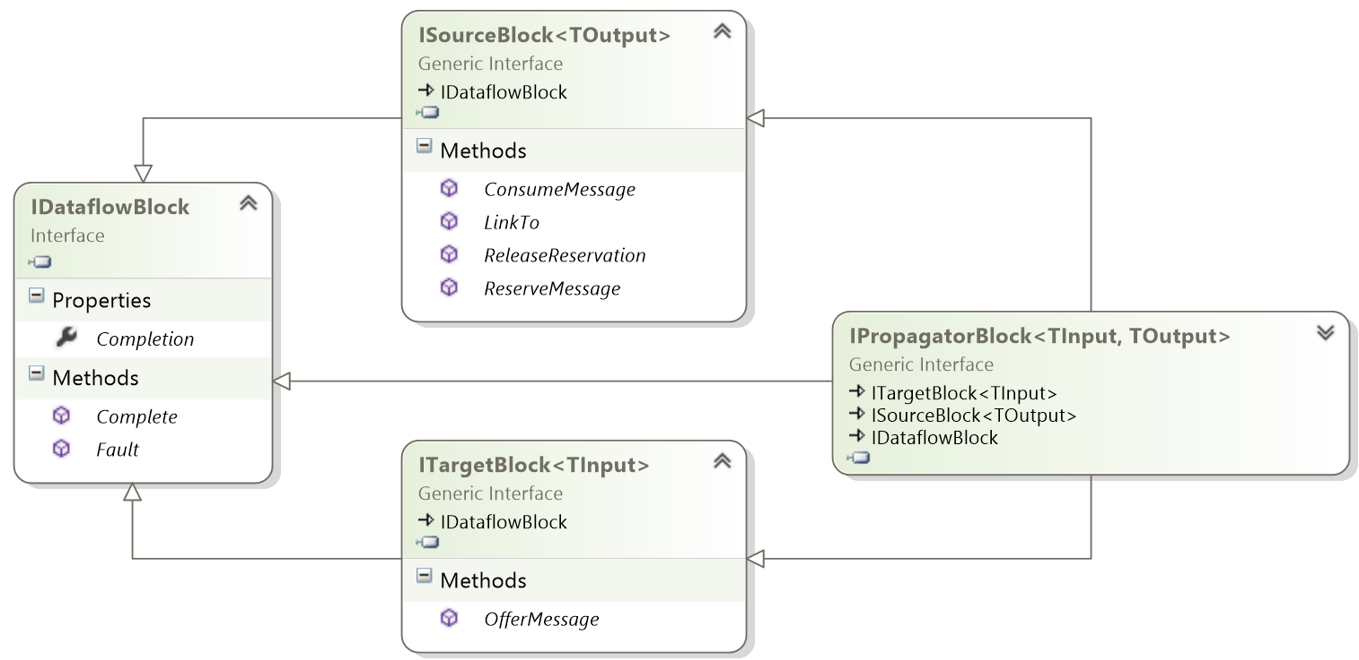
Notes:
IDataflowBlock – Basic properties and methods associated with all blocks. All of these are related to completion of the block
Recapping how dataflow works:
Source blocks offer data to linked target blocks. It does this by calling the implementations of ITargetBlock
Target blocks can then choose whether to consume or postpone the data. To do this, the target blocks call methods from ISourceBlock to reserve/remove messages from the source block for processing.
Linking of two blocks is always done from source to target and is done by calling the LinkTo method on the source block
IPropagatorBlock – Wraps source and target into a single interface. Most blocks that serve both roles will just inherit this interface.
Useful to inherit from IPropagatorBlock if you need a block that will expose custom methods or properties to public callers.
Note: There are extension methods in the dataflow library that abstract methods of these interfaces to simplify their use. i.e. Post, LinkTo, etc.

Slide 28
Encapsulating Blocks
DataflowBlock.Encapsulate will take in a target, source block reference and return an IPropagatorBlock
Useful when you simply want to represent multiple existing blocks as a single block.
Notes:
Erez will be showing more details about this.

Slide 29

Thank You
Contact Us
dave@taskmatics.com
erez@taskmatics.com
Download Taskmatics Scheduler
http://taskmatics.com/download
Get the slides and code samples
http://github.com/Taskmatics/code-camp-x-tpl-dataflow
Our Blog
http://taskmatics.com/blog

